Slide 1

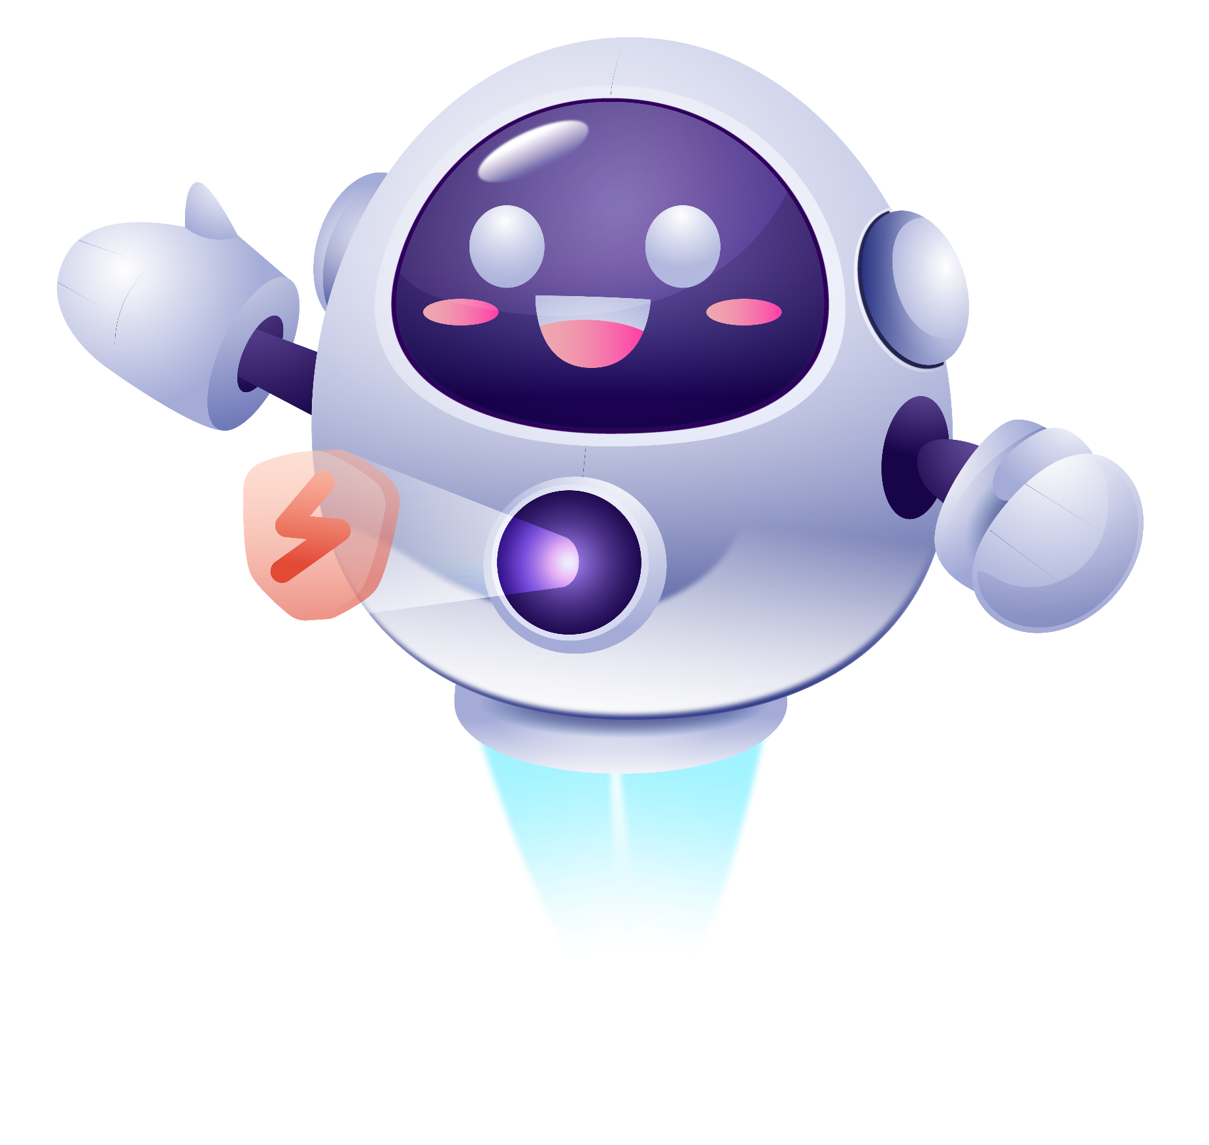


STEM Elective Subject for Middle School:
Principles of IT, Cybersecurity & Engineering
7th Grade
Here is where your presentation begins

Slide 2
Contents of this template
This is a slide structure based on a multi purpose presentation for education
You can delete this slide when you’re done editing the presentation
Fonts | To view this template correctly in PowerPoint, download and install the fonts we used
Used and alternative resources | An assortment of graphic resources that are suitable for use in this presentation
Thanks slide | You must keep it so that proper credits for our design are given
Colors | All the colors used in this presentation
Infographic resources | These can be used in the template, and their size and color can be edited
Customizable icons | They are sorted by theme so you can use them in all kinds of presentations
For more info: Slidesgo | Slidesgo School | Faqs
You can visit our sister projects: Freepik | Flaticon | Storyset | Wepik | VIDEVO

Slide 3
Table of contents
01
02
03
04
About it
History
You can describe the topic of the section here
You can describe the topic of the section here
Nowadays
Advices
You can describe the topic of the section here
You can describe the topic of the section here

Slide 4
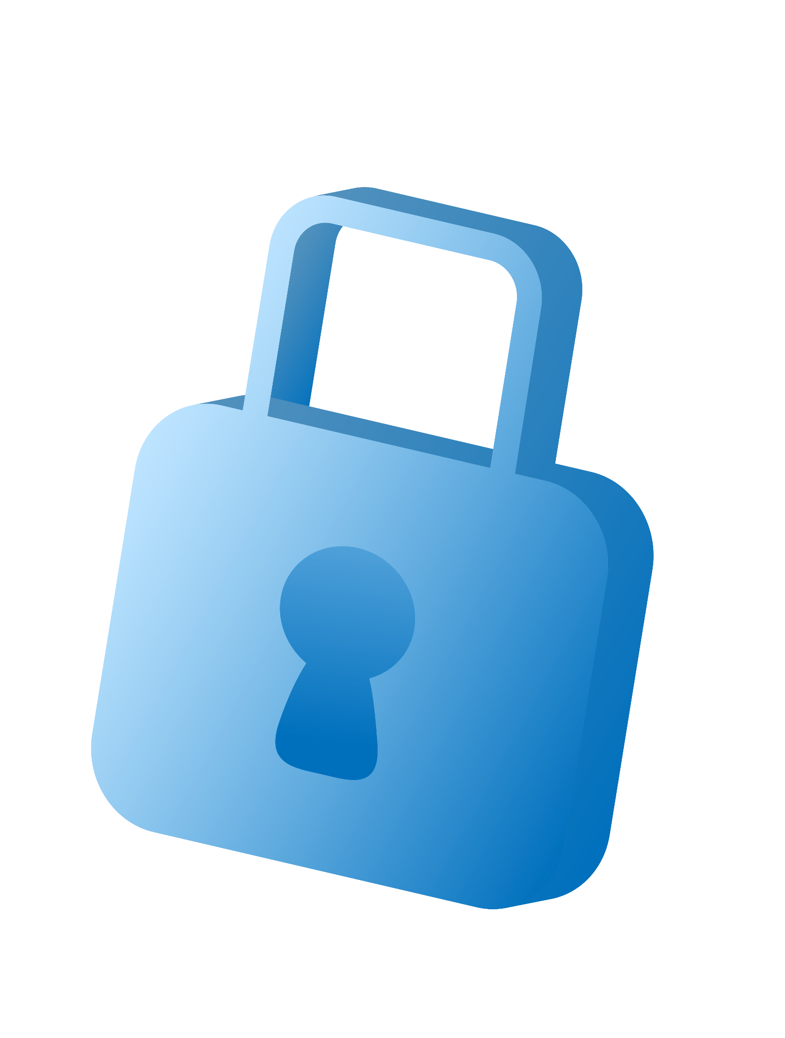
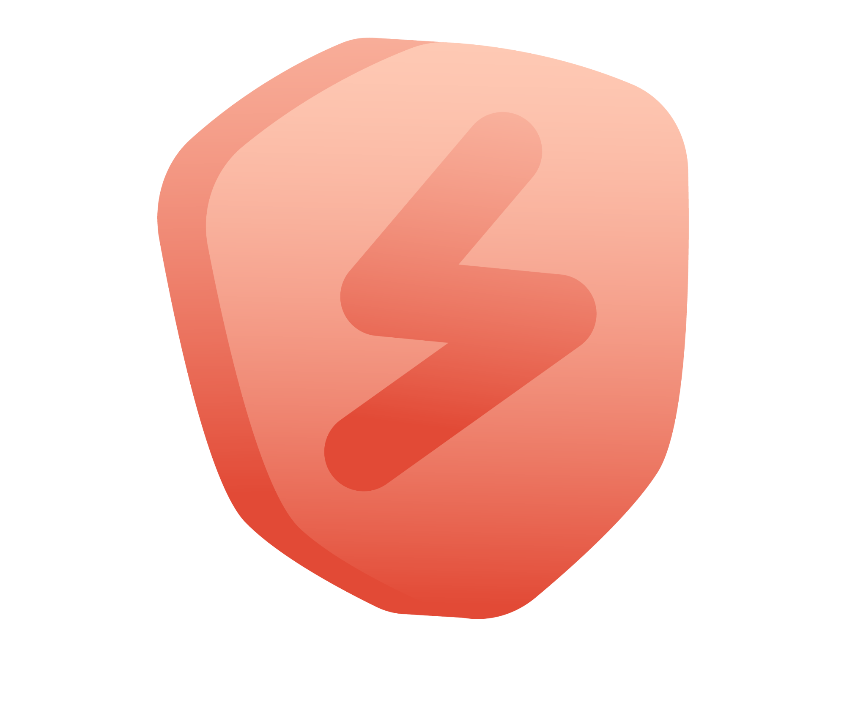
Whoa!
This can be the part of the presentation where you introduce yourself, write your email…

Slide 5
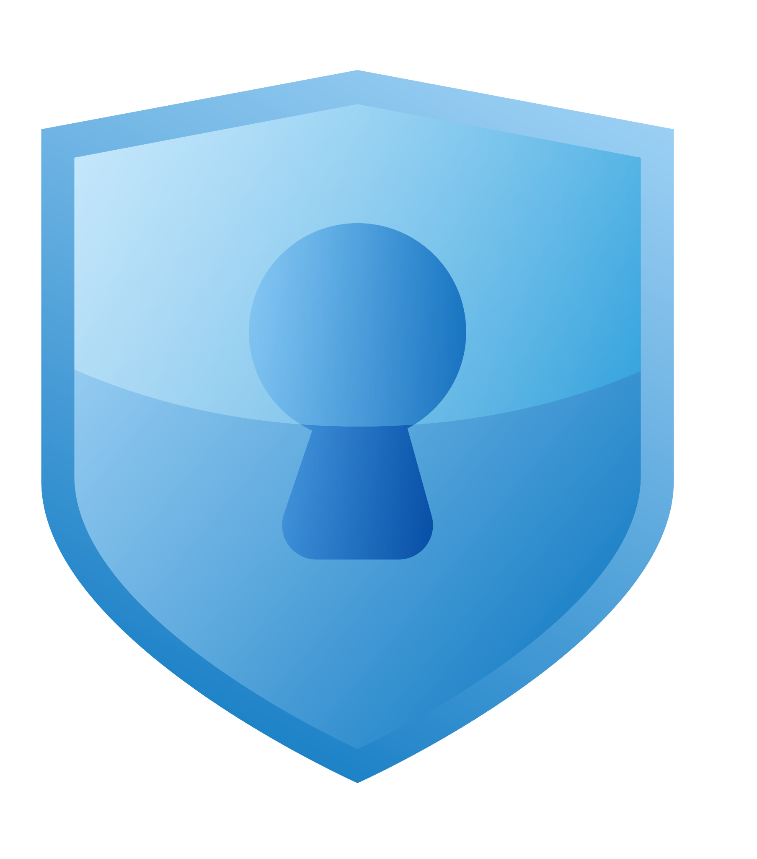
01
IT Principles
You can enter a subtitle here if you need it

Slide 6
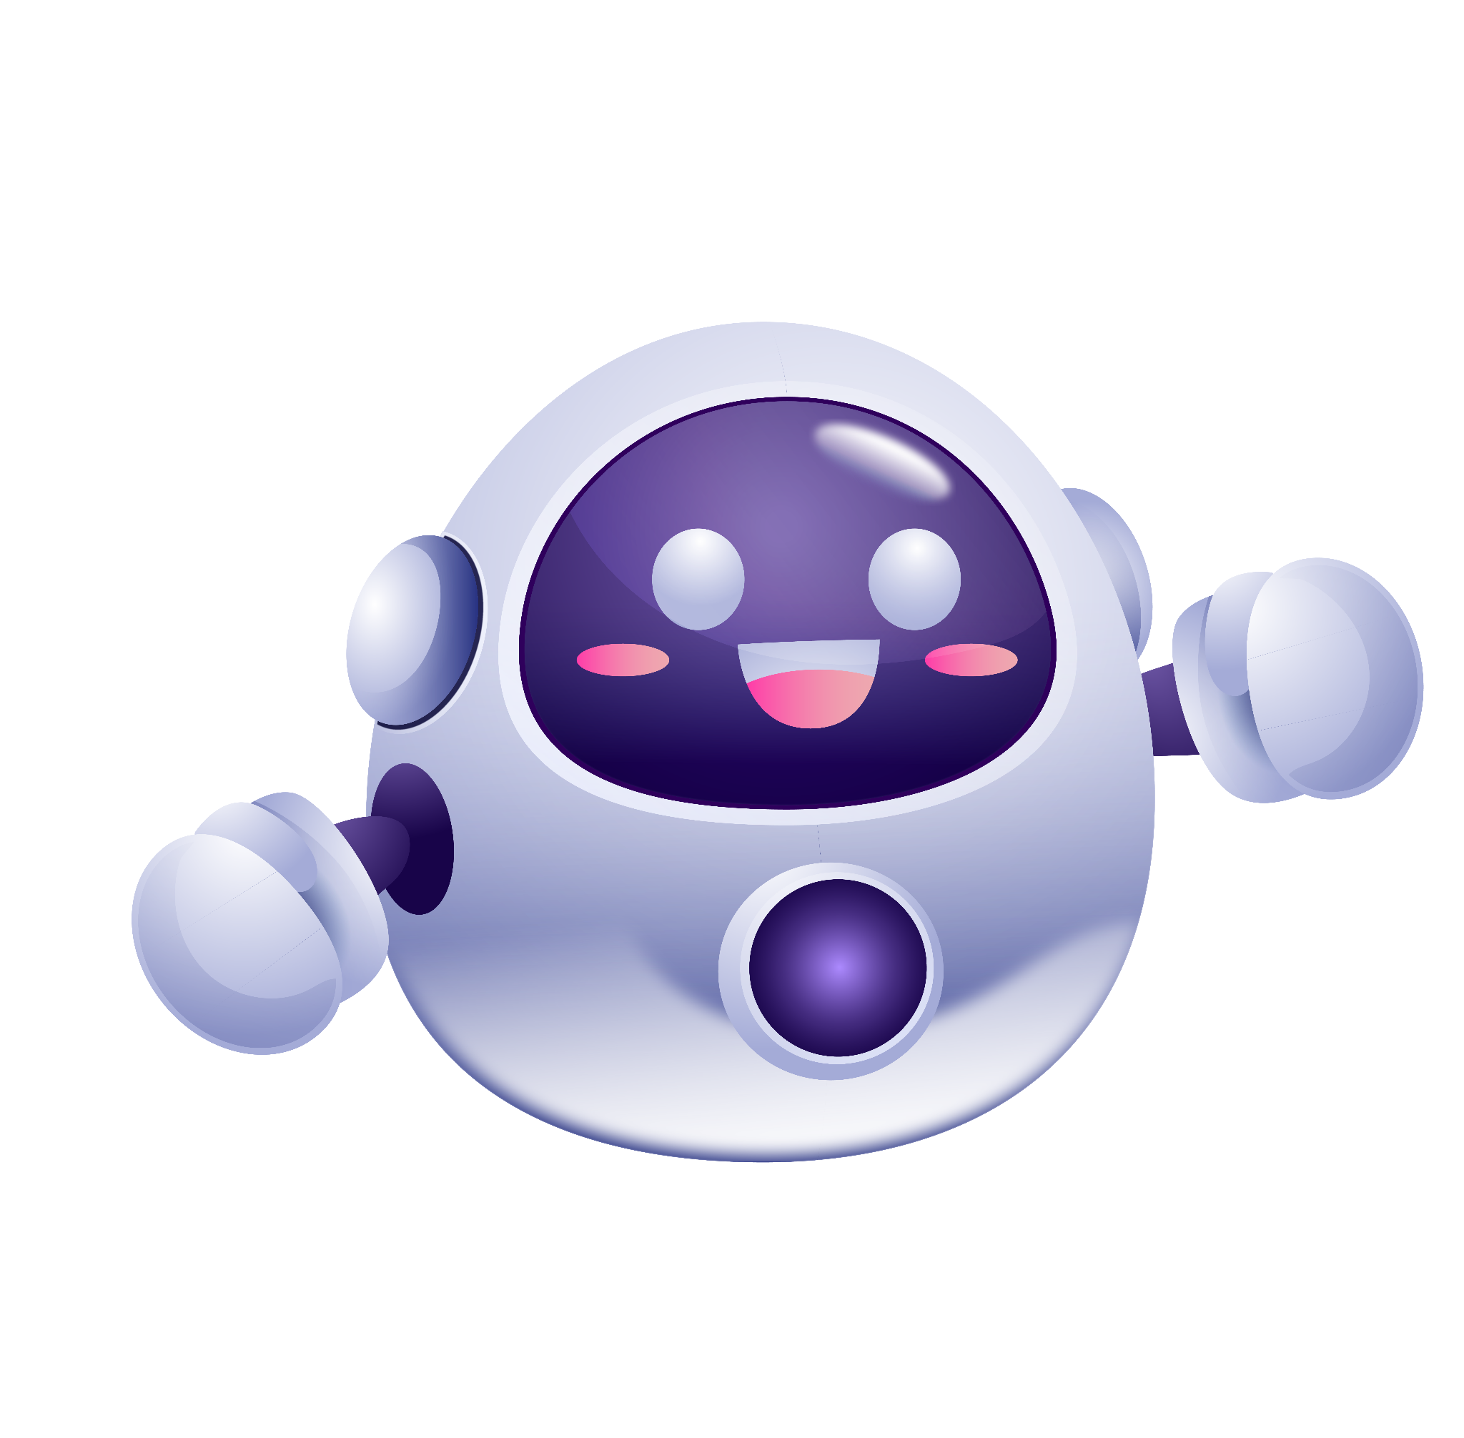
Keep IT skills and knowledge updated!
Do you know what helps you make your point clear? Lists like this one:
They’re simple
You can organize your ideas clearly
You’ll never forget to buy milk!
And the most important thing: the audience won’t miss the point of your presentation

Slide 7
Parts of cybersecurity
Technology
Mercury is the closest planet to the Sun and the smallest one in the Solar System—it’s only a bit larger than the Moon
Engineering
Venus has a beautiful name and is the second planet from the Sun. It’s hot and has a poisonous atmosphere

Slide 8
Conceptos about information
Confidentiality
Mercury is the closest planet to the Sun and the smallest one of them all
Integrity
Venus has a beautiful name and is the second planet from the Sun
Availability
Despite being red, Mars is actually a cold place. It’s full of iron oxide dust

Slide 9
Types of cybersecurity threats
Phishing
Ransomware
Despite being red, Mars is actually a cold planet
Venus has extremely high temperatures
Malware
Hacking
Jupiter is the biggest planet in the Solar System
Saturn is a gas giant and has several rings

Slide 10
Increase computer security
Politics
Control
Mars is actually a very cold place
Venus has a beautiful name
Functions
Defense
Neptune is an ice giant
Saturn is a gas giant with rings
Information
Training
Mercury was named after a god
Jupiter is a gas giant and big

Slide 11
Awesome words

Slide 12
—Someone Famous
“This is a quote, words full of wisdom that someone important said and can make the reader get inspired.”

Slide 13
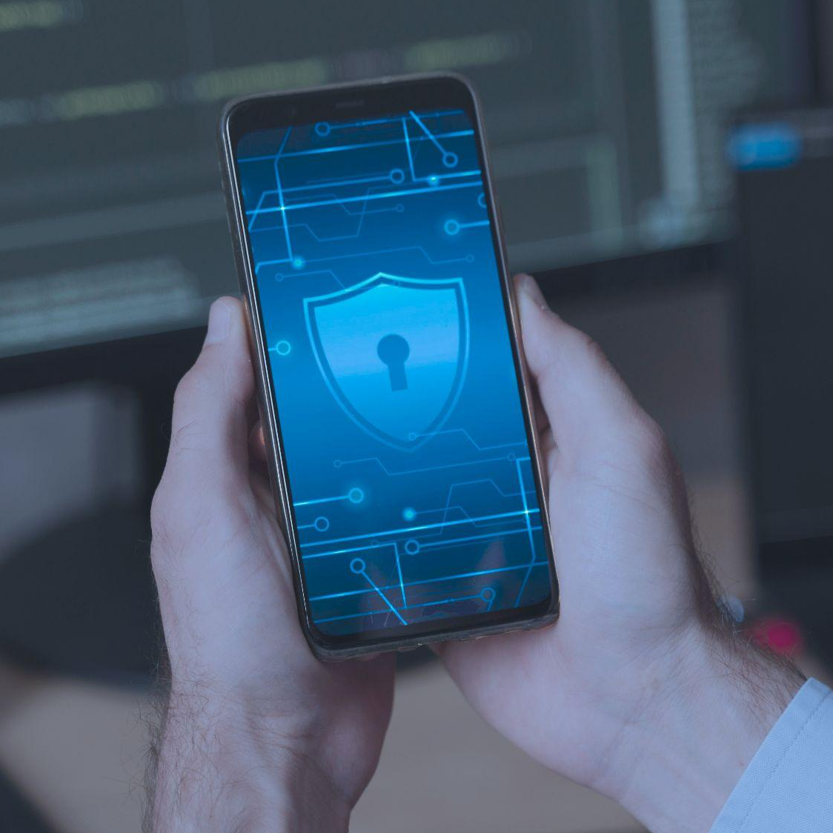
Don't forget to protect your passwords
Images reveal large amounts of data, so remember: use an image instead of a long text. Your audience will appreciate it

Slide 14
300,000
Big numbers catch your audience’s attention

Slide 15
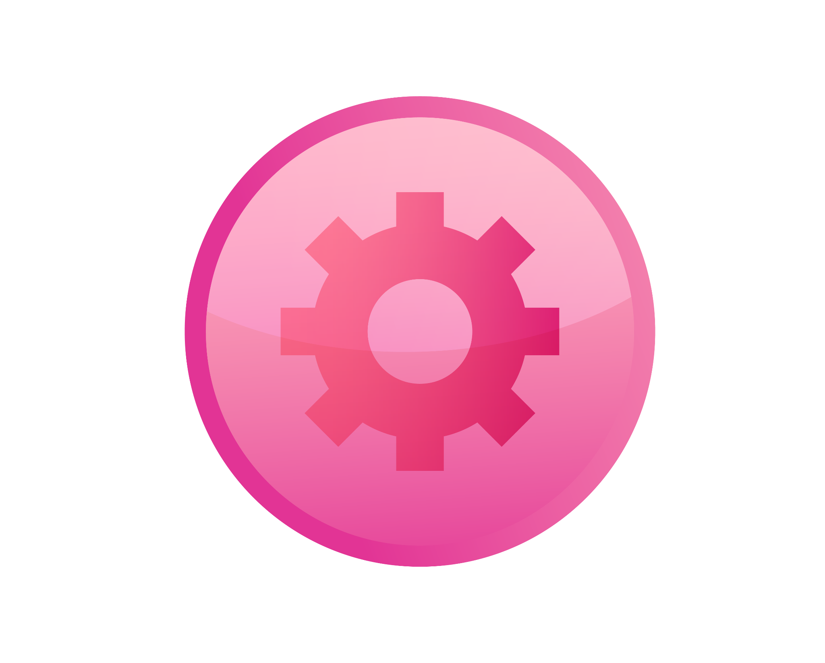
$415,654
45 days
11 seconds
Jupiter's rotation period
The Sun’s mass compared to Earth’s
Distance between Earth and the Moon

Slide 16
Long-tail cost of cyber attacks
25%
50%
75%
First
Third
Mercury is the closest planet to the Sun and the smallest one of them all
Second
Despite being red, Mars is actually a cold place. It’s full of iron oxide dust
Venus has a beautiful name and is the second planet from the Sun

Slide 17
Where come from cyber attacks
China
Venus is the second planet from the Sun
Brazil
Mercury is the closest planet to the Sun

Slide 18
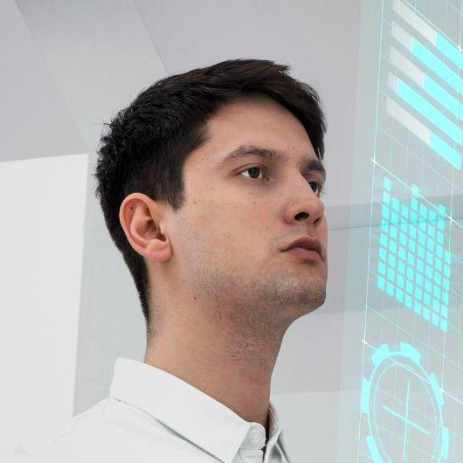
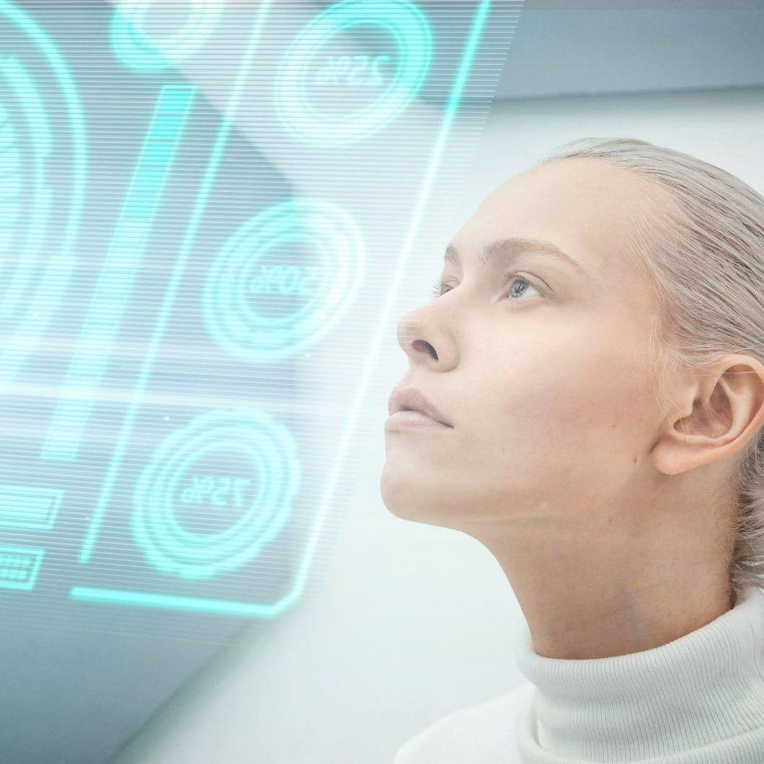
IT team
Tommy Hill
Sara Harris
You can speak a bit about this person here
You can speak a bit about this person here

Slide 19
Viruses and malware in history
Venus is the second planet from the Sun
Despite being red, Mars is a very cold planet
1970
1990
Creeper
Elk Cloner
The Chameleon
Downadup
1980
2000
Mercury is the closest planet to the Sun
Jupiter is the biggest planet of them all

Slide 20
Amount of time to crack passwords
Password | Numbers | Time
abcdefg | 7 characters | 29 milliseconds
abcdefgh | 8 characters | 5 hours
abcdefghi | 9 characters | 5 days
abcdefghij | 10 characters | 4 months
abcdefghijk | 11 characters | 1 decade
abcdefghijkl | 12 characters | 2 centuries

Slide 21
What does STEM stands for?
Science
S
Mars is actually a very cold place
T
Technology
Venus has extremely high temperatures
Engineering
E
Mercury is the closest planet to the Sun
M
Mathematics
Saturn is a gas giant and has several rings

Slide 22
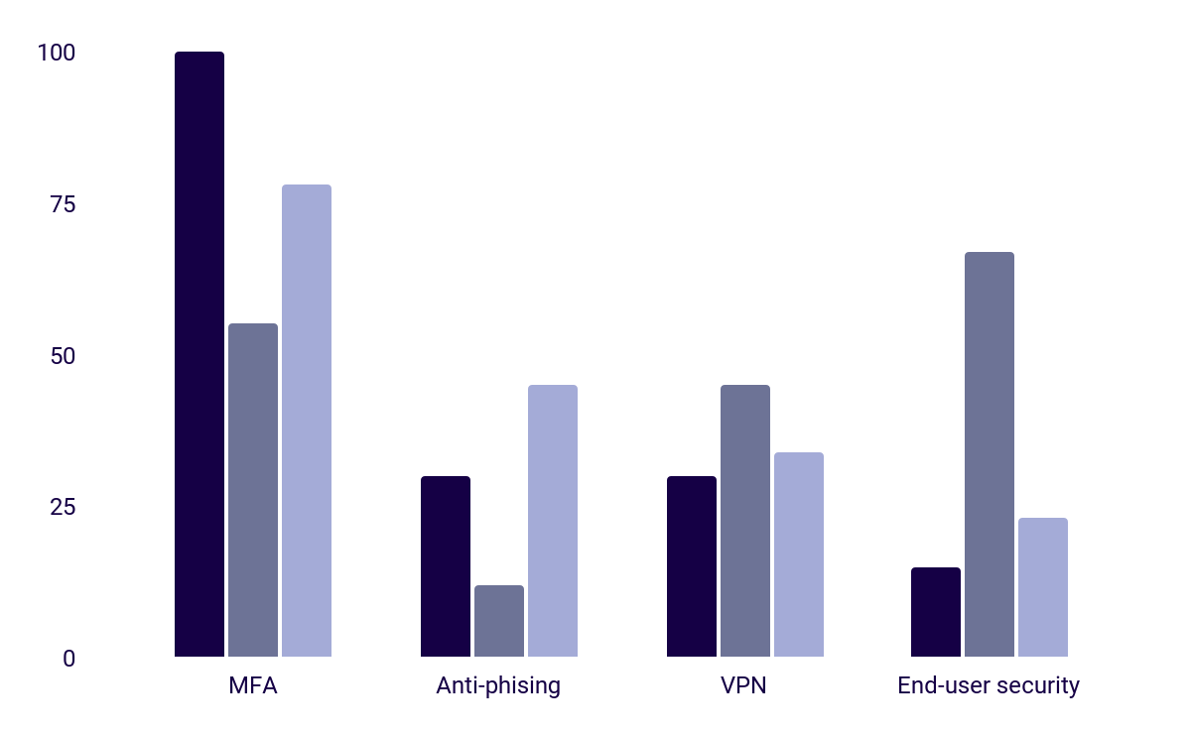
Investments during pandemic
Conclusions about it
Earth is the third planet from the Sun and the only one that harbors life in the Solar System. This is where we all live
$3,456,590 Total money invested
US
UK
IN
Follow the link in the graph to modify its data and then paste the new one here. For more info, click here

Slide 23
Cyber security symbols
Site threat
Antivirus
Security
Protection
Protection
Cybersecurity

Slide 24
Cybersecurity knowledge graph
Leave
Evidence
Depend
Vulnerability
Against
Threat
Uses
Vulnerability
Locate
Depend
Asset
Against
Location

Slide 25
Safety payment concepts
Virtual money
Cryptocurrency
Neptune is the farthest planet from the Sun. It's also the fourth-largest object by diameter in the Solar System
Earth is the third planet from the Sun and the only one that harbors life in the Solar System
Safe online shopping
Jupiter is a gas giant and the biggest planet in the Solar System. It's the fourth-brightest object in the night sky. It was named after the Roman god of the skies and lightning

Slide 26
Cyberattacks in education
Information
Cases
Earth is the third planet from the Sun and the only one that harbors life in the Solar System. This is where we all live on
1,200 students
Denial
7%
Affected
12%
Ransomware
Other
45%
400 schools
36%
Data breach
21 m of people
Hacked

Slide 27
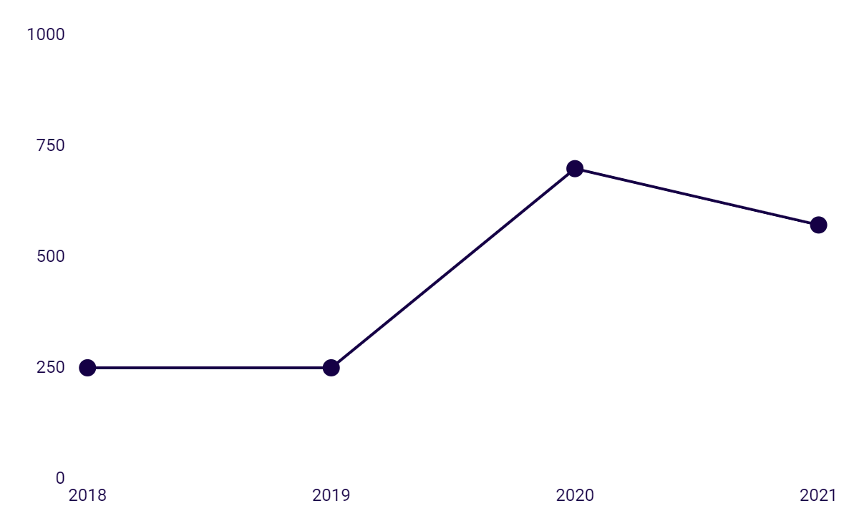
Global annual attacks
Jupiter is a gas giant and the biggest planet in the Solar System
Year | Attacks
2018 | 250
2019 | 250
2020 | 699
2021 | 572
Follow the link in the graph to modify its data and then paste the new one here. For more info, click here

Slide 28
You can follow this steps
How to be safe online?
Privacity
Be careful
Ask for help
Check settings
Well done!

Slide 29
What is a hacker?
White hat
Definition
Crackers
Characteristics and role
Characteristics and role
Characteristics and role
Neptune is the farthest planet from the Sun. It's also the fourth-largest object by diameter in the Solar System
Characteristics and role
Characteristics and role
Characteristics and role

Slide 30
Checklist for security online
I have a unique, strong password for each of my accounts
I am using a password manager
I enable multi-factor authentication on all my accounts
I deleted apps that I don’t use
Jupiter is a gas giant and the biggest planet in the Solar System. It's the fourth-brightest object in the night sky. It was named after the Roman god of the skies and lightning

Slide 31
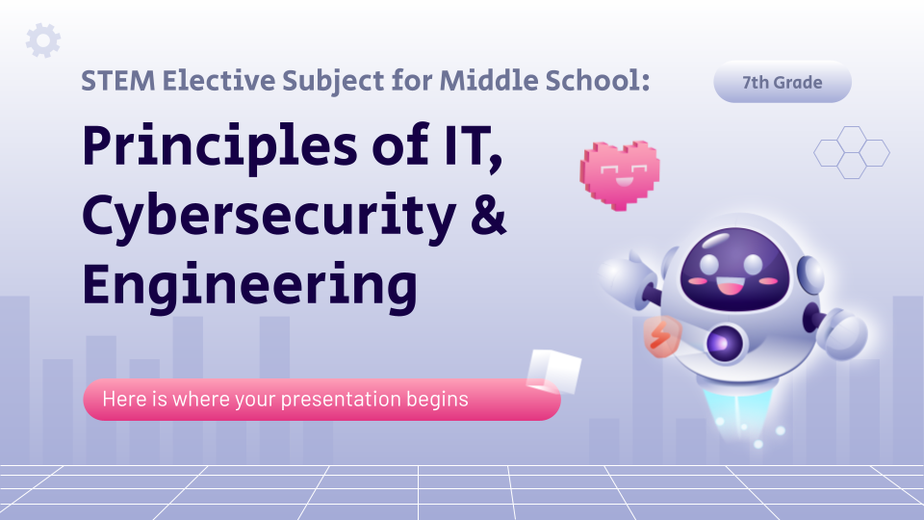
PC mockup
You can replace the image on the screen with your own work. Just right-click on it and select “Replace image”

Slide 32
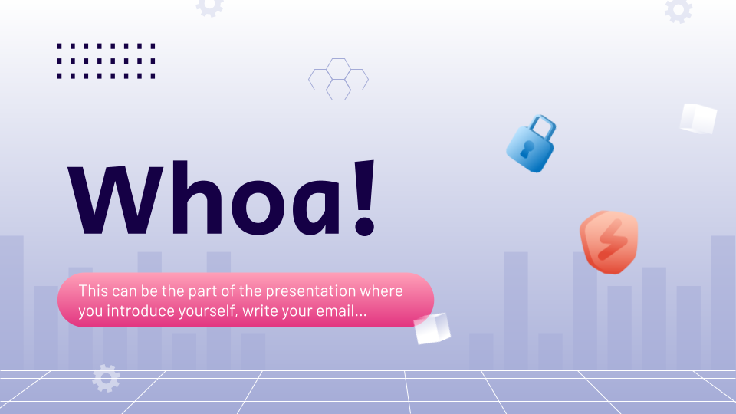
Tablet mockup
You can replace the image on the screen with your own work. Just right-click on it and select “Replace image”

Slide 33
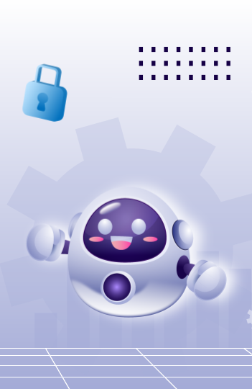
Phone mockup
You can replace the image on the screen with your own work. Just right-click on it and select “Replace image”

Slide 34
Thanks!
Do you have any questions?
youremail@freepik.com
+34 654 321 432
yourwebsite.com
Please keep this slide for attribution

